Slide 1
How to Make Games at Home for Cheap
Or, How to Stop Worrying and Just Go Indie

Slide 2

Let’s Begin by Crushing Some Dreams…
Most indie success stories are flukes. For every millionaire doing what we do, there are tens of thousands of us who’ve yet to break 3, or even 2 figures in sales.
An idea is worthless if it isn’t in the hands of someone capable of delivering on it. Those people usually have plenty of their own ideas.
The bigger an idea is, the harder it is to get it off the ground. Unless you’ve been doing it a while you probably don’t have a good perspective of scale so there’s a good chance whatever you want to do is too big for you to tackle right now.
You will never see an MMO to release.

Slide 3
The Good News
If you still want to make games after that last slide, congratulations, you’re well on your way to being a developer!
Getting started can be fun, easy, and best of all free!
Just about every game development tool available has a free or cheap alternative.
Interest in game development has soared in recent years. This has led to an incredible volume of resources for aspiring developers. It has never been easier to get started.
The tools and resources we’ll be showing you here are all you need to make your first game.

Slide 4
What Do You Need to Make a Game?
An engine
Art
Sound
Place to put it

Slide 5
What Do You Need to Make a Game?
An engine

Slide 6
What is a Game Engine?
A game engine is a collection of standard resources required by most games. These include systems for rendering graphics, handling collisions and physics, etc...
Most developers primarily interface with the editor portion of the engine.
While there are engines that are build to make one style of game, most of the popular engines can be used to make any sort of game you can think of.
Engine isn’t super important, don’t get caught in that trap. Just pick one and run with it

Slide 7

Game Engines
Engine | Price | Need to Code? | Language | Royalties | License | Platforms | Popular Games
Unity | 0 - 125 mo. | Yes, but has visual scripting options | C# | No | Proprietary | PC, Consoles, VR | Hearthstone, Outer Wilds, Cuphead
Unreal | 0 | Yes, but has visual scripting options | C++ | Yes | Proprietary | PC, Consoles, VR | Borderlands 3, Days Gone, Unreal Tournament
Game Maker | 39-199 | No, but you can | GML | No | Proprietary | PC, Consoles | Hyper Light Drifter, Nuclear Throne, Spelunky
Godot | 0 | Yes | Python | No | Open Source | PC, Consoles, VR | Stereobreak, Deep Sixed, Shipwreck
RPG Maker | 4-20(sale price) | No, but you can | RGSS | No | Proprietary | PC | To the Moon, Skyborn, Corpse Party
Twine | Free | No | HTML/CSS | No | Open Source | PC | Depression Quest, Open Sorcery, The Temple of No

Slide 8
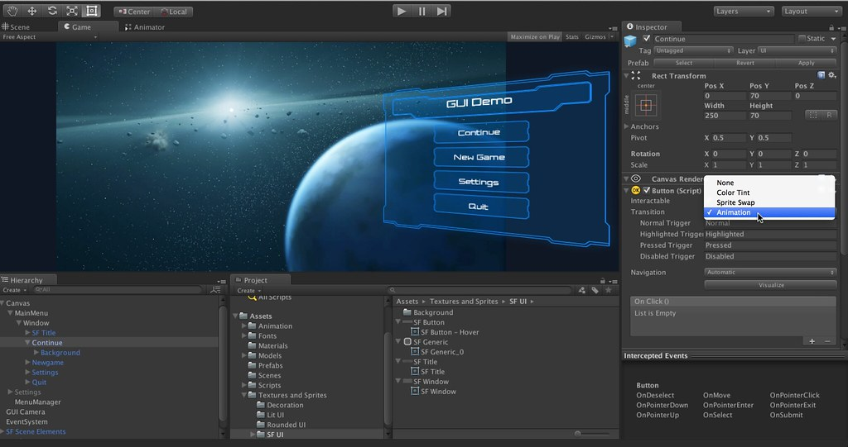
Unity
Pros
Industry standard software.
Powerful and flexible
Supported by massive community
One of the most thoroughly documented engines
Ability to extend the editor functionality with script
Cons
Difficult for beginners
UI tools can be unintuitive
Can occasionally be pretty buggy

Slide 9
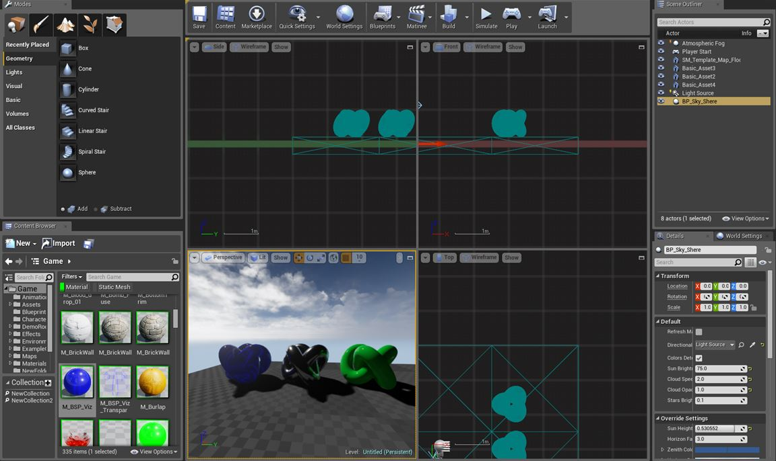
Unreal
Pros-
High Quality Rendering Pipeline – Pretty Graphics!
In-Engine Material Editor
Access to source code
Visual scripting
Cons
High learning curve
Lack of Documentation
Large project size
Expected to use Blueprints – can get messy and hard to maintain
2D support is lacking, and it doesn’t seem to be a focus at Epic

Slide 10
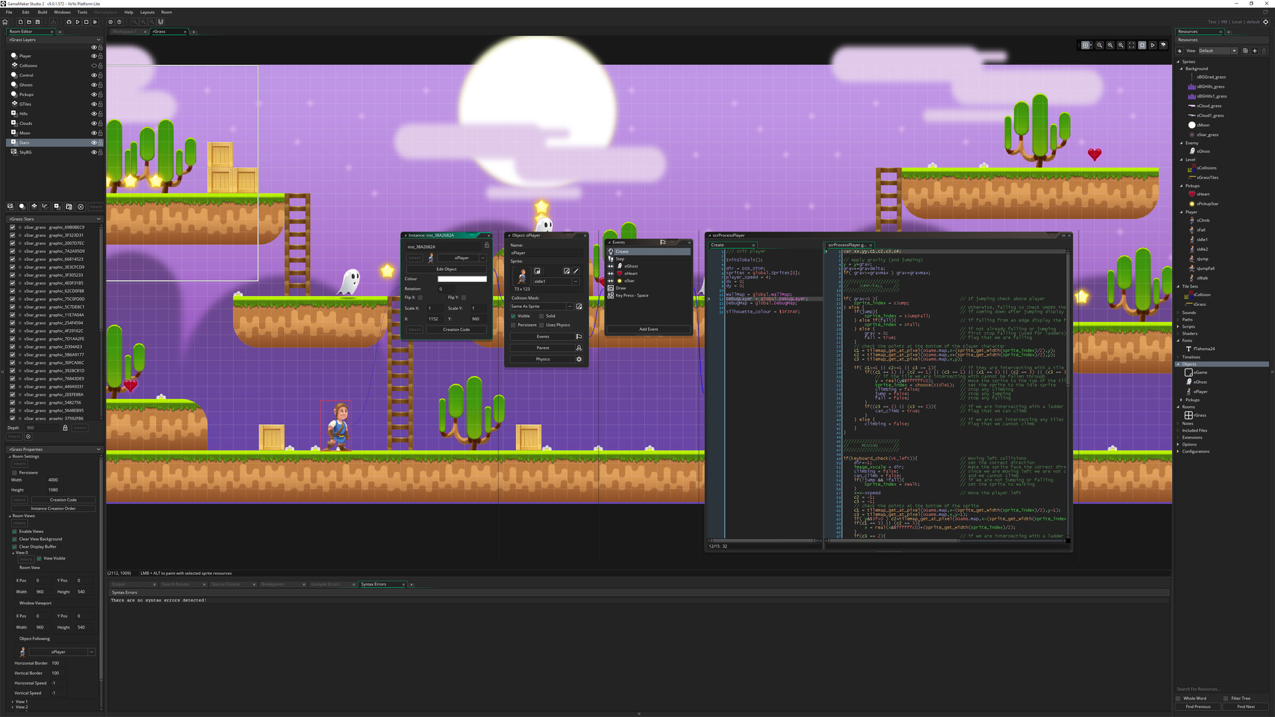
Game Maker
Pros
Easy for beginners
Robust visual scripting tools
If you buy it once, you have it forever. No additional licenses or royalties are necessary.
Cons
Unsuitable for 3D development
The more you learn, the more control you’ll want. The ease of use that makes it great for beginners can make it frustrating for advanced users.

Slide 11
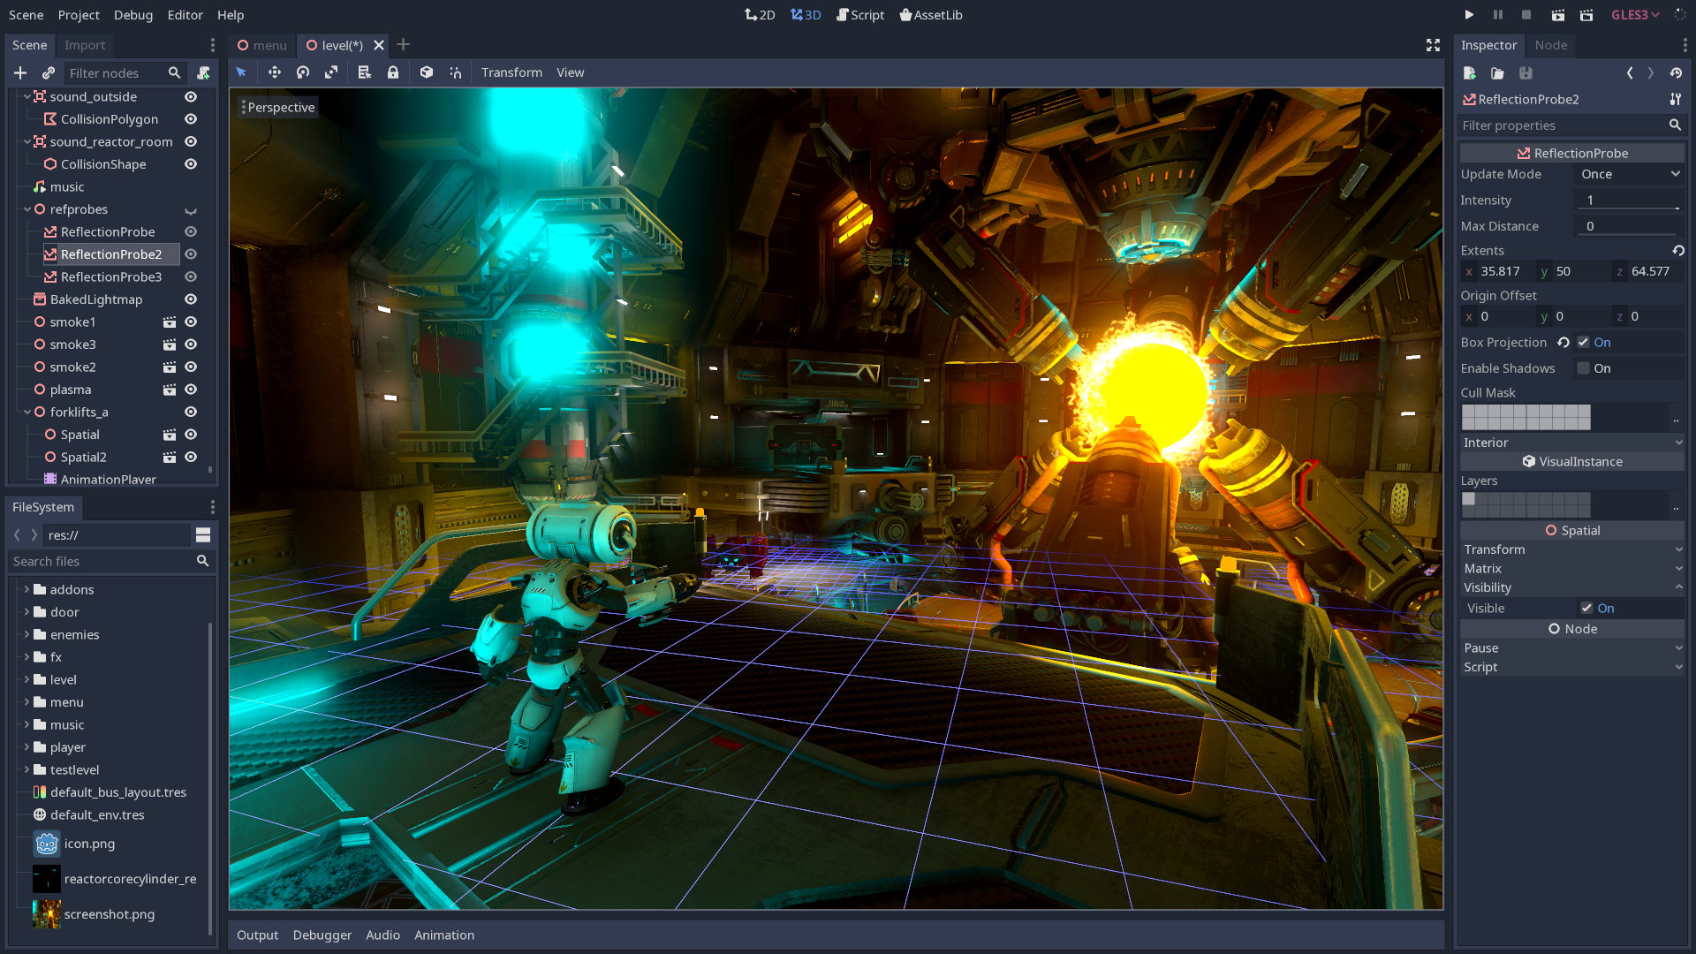
Godot
Pros
Completely free and open source
Just about as robust and powerful as its major competitors
Uses GDScript, a relatively easy-to-learn language based on Python
Cons
The project is crowdfunded so updates and new features are pretty slow
Limited resources for learning the engine
Limited documentation
Small community

Slide 12
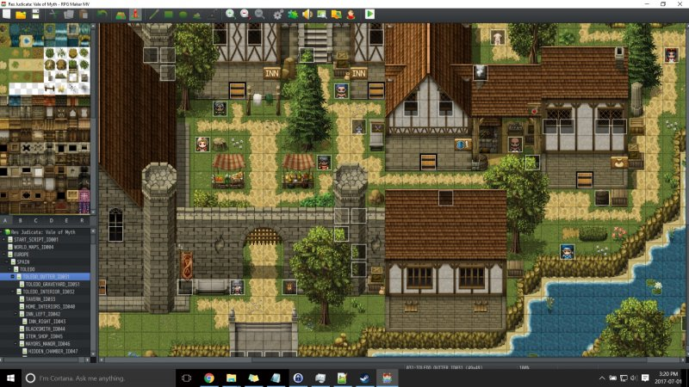
RPG Maker
Pros
Simple to use
Simplifies and streamlines a generally difficult to make game type
Premade Assets and Characters
Active community
Cons
Only really meant to make RPG’s
Coding for it has next to no documentation
Has a distinctively cheap look if premade assets are used
Hard to extend functionality

Slide 13
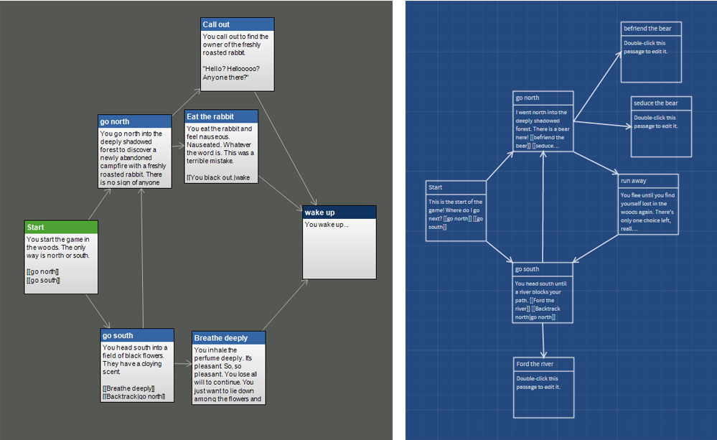
Twine
Pros
Easy to use
No programming required
Good for writers
Cons
Only really does text and still images
Can’t do much with it outside of visual novels and branching logic games

Slide 14
What Do You Need to Make a Game?
An engine
Art
Sound
Place to put it

Slide 15
What Do You Need to Make a Game?
Art

Slide 16

Why You Should Art
You maintain ownership of the thing you’re making
You don’t have to worry about licensing or paying royalties or fees
Having a working understanding of every part of a project makes you a better teammate and a better project manager
It’s hard to build teams without resources, if you have a visual proof of concept, it’s easier to attract artists to your project

Slide 17
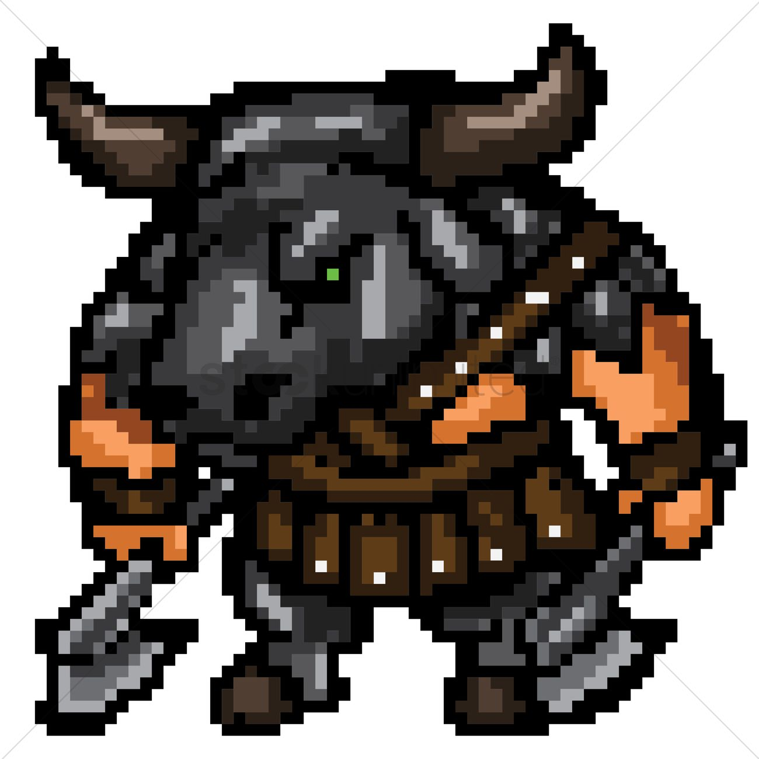
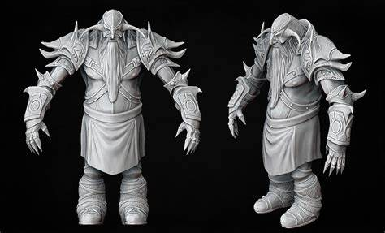
Tools for Making Art
2D
3D

Slide 18
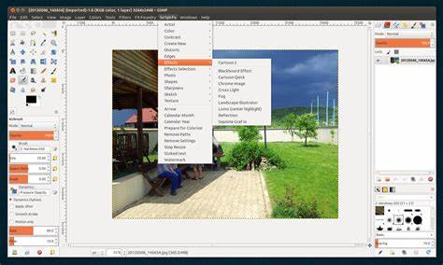
Gimp
Similar to Photoshop, for those familiar with that program
Robust suite of open source tools
Easy for programmers to write tools for

Slide 19
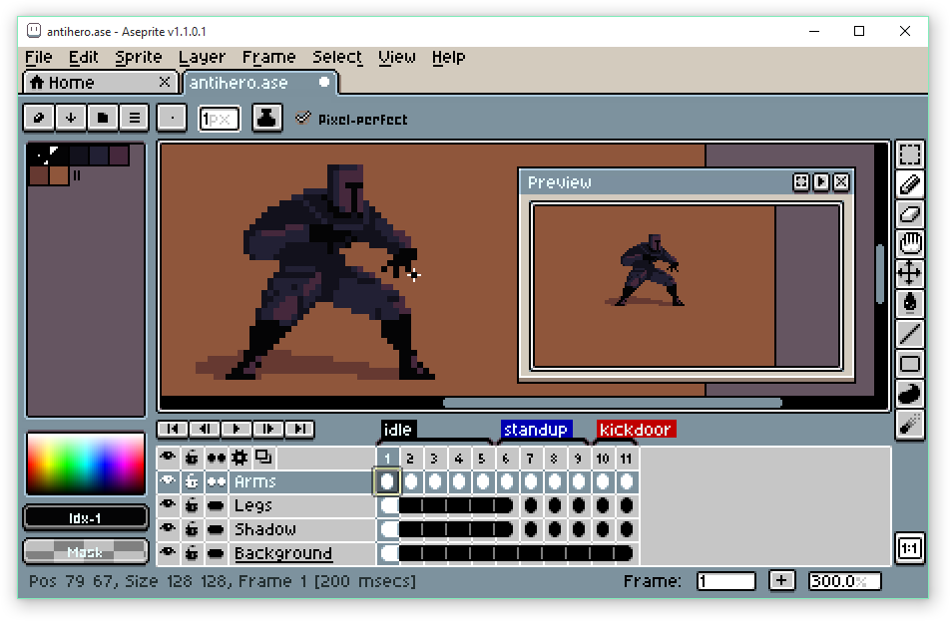
Aseprite
Everything you need to make pixel art and nothing else
Robust animation tools
Export sprite sheets for animation stitching

Slide 20
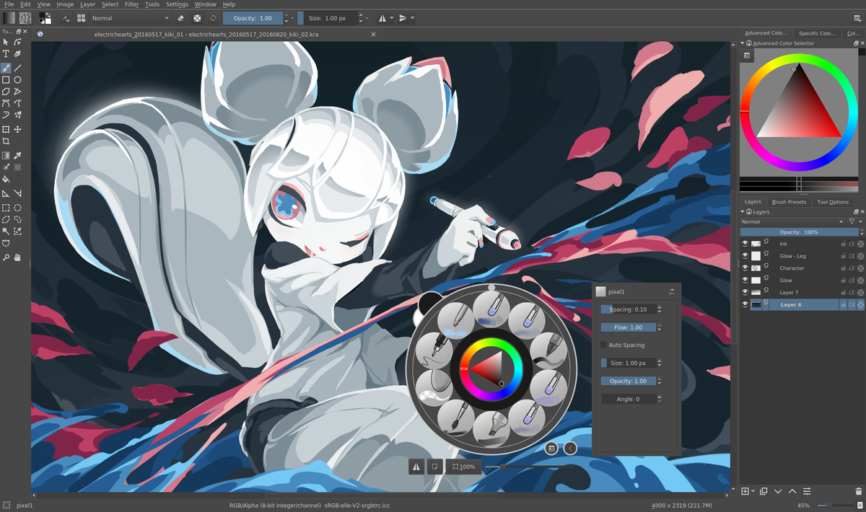
Krita
Digital painting application
Great to use with a graphics tablet
Good for making hand-drawn sprites and backdrops

Slide 21
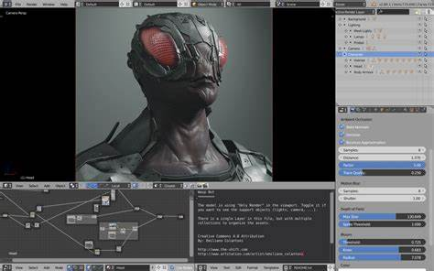
Blender
Totally free and open source
Does everything every major competitor does
Incredibly steep learning curve, but an incredibly good investment

Slide 22
What Do You Need to Make a Game?
An engine
Art
Sound
Place to put it

Slide 23
What Do You Need to Make a Game?
Sound

Slide 24
What is Sound For?
One of the most important factors in development is ‘Game Feel’
Sounds are absolutely vital in game feel
Solid sound effects ground actions
Dynamic music can inform the player’s feelings toward the game

Slide 25
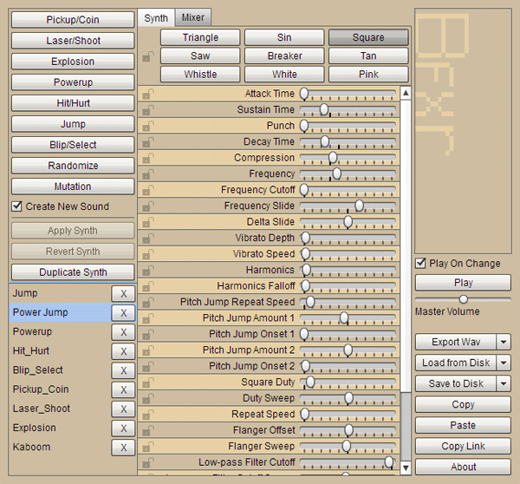
SFX Tools
The first and last word in generating simple sound effects is Bfxr
Browser based, but there is a lightweight desktop app
Can generate a wide range of synthesized sound
Just about any ‘gamey’ sound you can imagine can be produced with this program

Slide 26
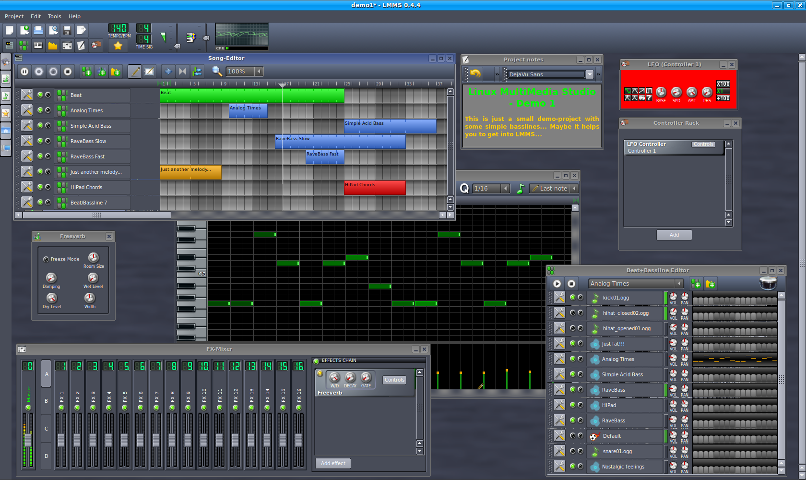
Music Tools
Sequencing is probably the easiest way for non-musicians to make their own music
Most tools have a ‘piano-roll’ where they can select notes individually and listen back in real-time
BeepBox and LMMS are two of the best and simplest tools for sequencing and looping simple tracks

Slide 27
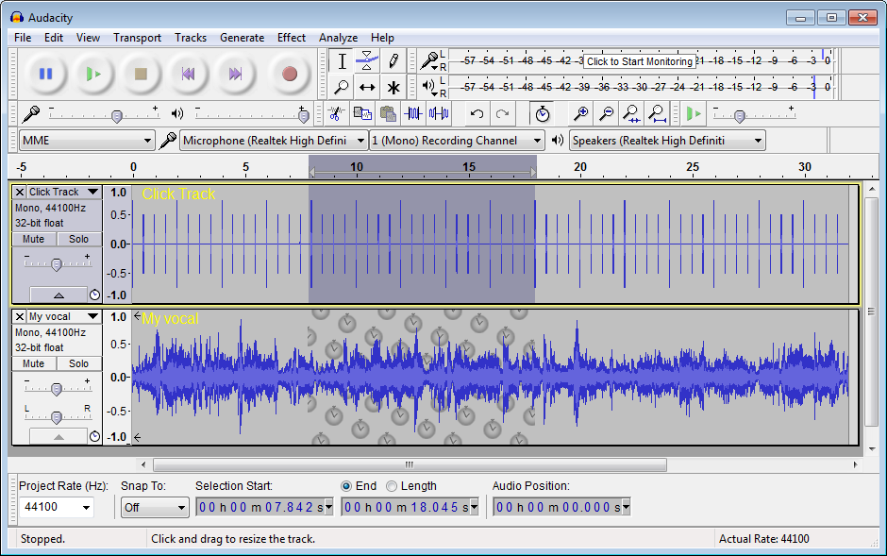
Foley Sound and Direct Capture
The best free tool for capturing and editing audio is Audacity
Audacity goes as deep as you need it to, the average person has no reason to use all of its features
Foley sounds are a fun way to mix up your game design and add a personal touch
As fun and retro as computerized music is, if capturing a real instrument being played is an option, it can be a unique way to set your game apart

Slide 28
What Do You Need to Make a Game?
An engine
Art
Sound
Place to put it

Slide 29
What Do You Need to Make a Game?
Place to put it

Slide 30
Free Hosting
Some sites offer free hosting for games. These sites have a wide variety of features and monetization options. Here are a few of note:
Itch.io – Full on games market place. Store cut of profit is optional. Many creators to provide feedback.
Newgrounds – Longstanding platform; Only supports web based games.
Game Jolt – Similar to itch, but no monetization.
Kongragate - Similar to itch and Game Jolt, but no monetization.

Slide 31
Paid Hosting
Paid services and storefronts. These are more for retail releases and monetized games.
Steam – Huge storefront with lots of games and achievement options.
Epic store – New storefront that takes less of a cut per sale; Lacks some of the features Steam has.
Humble Store – Online storefront that allows for donations to charity as part of the sale.
GOG – Storefront that sells DRM free copies of games.

Slide 32
The Indie Economy
Golden rule of independent game design – If you spend money to make a game, you’ve lost money.
There is a lot of money in the scene, just not for any of us.
Passion does not always lead to high sales, You have to find the balance between passion and marketability.
Marketing is key, and none of us can afford marketing

Slide 33
Useful Resources
Itch.io – Lots of devs release asset packs and tools for free or on the cheap.
Reddit (r/Gamedev, r/[insert engine]) – lots of useful posts and help on engine specific problems
Stack Overflow – More on the coding side, but there is nothing these people can’t answer.
The Official Forums for your Engine – Much like the others, there is specific help and mods that actually work for the company that supports the engine.
OpenGameArt.com – Literally thousands of free assets to use in prototypes and jams

Slide 34
Parting Advice
The only thing you need to do to be a game developer is to develop games.
Done is better than perfect
Start Small

